Slide 1




REFREC-TR Project
Integrating Syrians into Turkish Higher Education through Recognition of Qualifications

Slide 2
Project Consortium:
Yasar University UNESCO Chair on International Migration
Turkish Ministry of Interior, Izmir Provincial Directorate General of Migration Management (Izmir DGMM)
Norwegian Agency for Quality Assurance in Education (NOKUT)
Period: December 2017-February 2019

Slide 3
AIMS of the Project
To develop a comprehensive, functional and tailor-made suggestion of a recognition tool for Turkish higher education concerning Syrians with documents that needs to be validated and more specifically Syrians without proper documents
To publish a comparative research report and a guideline for Turkish higher education system by conducting an evidence-based academic research on how to better cope and integrate Syrians and prospective refugees into Turkish higher education system.
REFREC-TR

Slide 4
Testing NOKUT's “Qualification's Passport for Refugees” and benefit from the interview technique, recognition experience

Slide 5
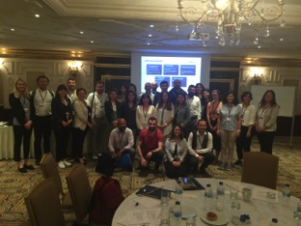
Training Programe on Recognition Processes
22 May, 2017, Istanbul
44 participants from universities, policy institutions and NGOs
Procedures, prospects and challenges on Syrians’ access to Turkish higher education

Slide 6
TESTING NOKUT’S QUALIFICATIONS PASSPORT
11 Syrian candidates were interviewed in 2 days by 3 credential evaluators from NOKUT
Interviews took place in cooperation with Turkish Red Crescent Sultanbeyli Community Center and Refugees Association
What we observed? How to contribute to the cases in Turkey?
  Divergent refugee profile in Turkey (admitted in Syria (not yet enrolled), graduate in Syria, high school diploma?)
  Need for academic evaluation and assessment of qualifications
  No problem at all in accessing higher education, procedures are clear and flexible within university’s competence area
  Challenges: Regular attendance, recognition of courses, equivalency of competences
  The technique is useful for advisory boards at universities for verbal evaluation
  Companies, civil society might also benefit from the QP in terms of working with refugees.

Slide 7
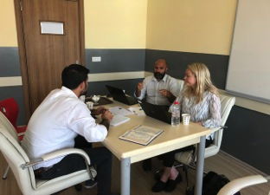
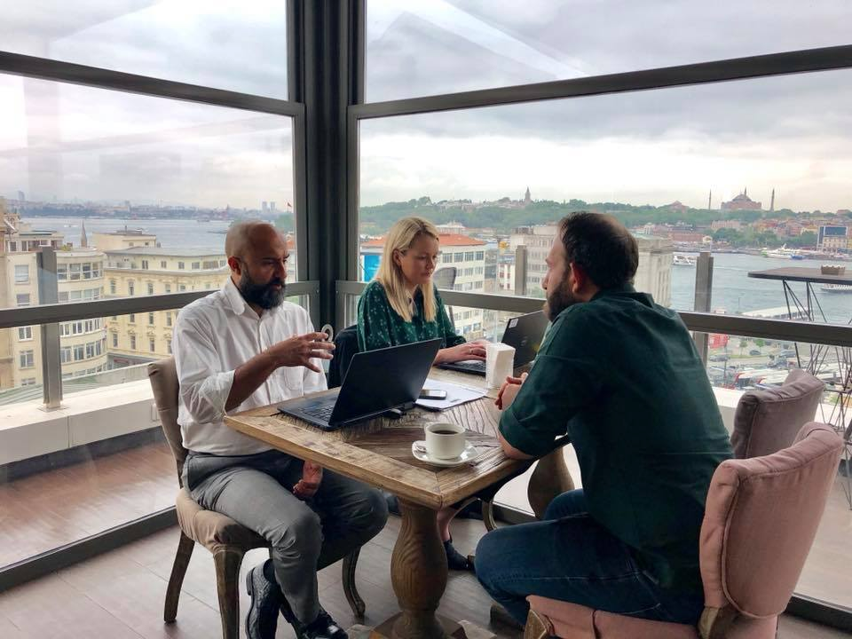
Achievements
QP works well in Turkish case as well
We need a database as NOKUT has
Different context of candidates’ profile in Turkey
Contributions to NOKUT’s QP
How Turkey can benefit?
New partnerships
Challenges
Reaching candidates and informing them
Participation of female candidates
Advice for further guidance
Translator
Special thanks to Turkish Red Crescent Sultanbeyli Community Center and also Refugees Association

Slide 8
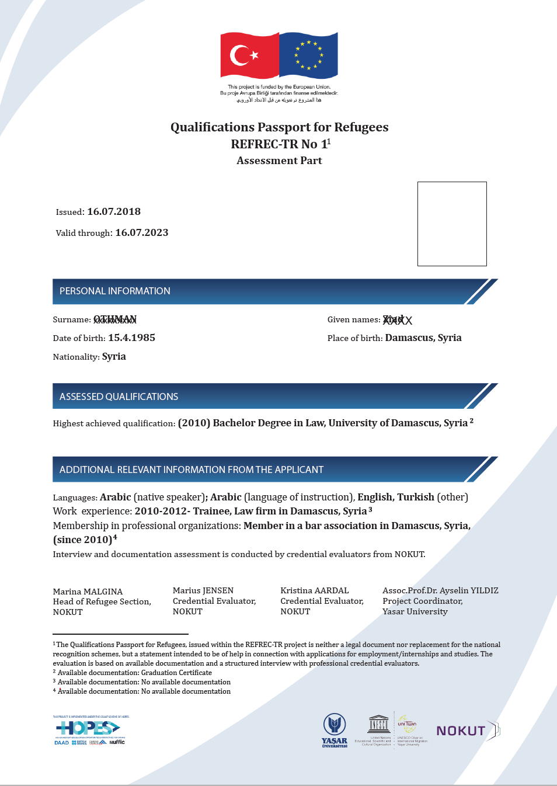
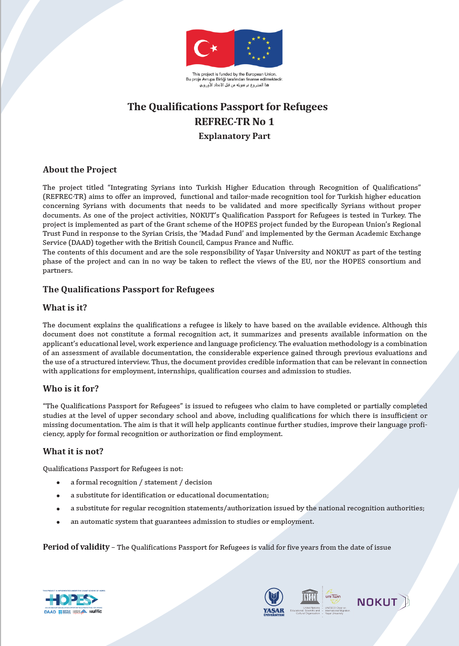

Slide 9
Interviews conducted: Good Practices
Gaziantep University
Mersin University
Cukurova University
Koc University
INGEV (HOPES Project)
! Not a good practice due to administrative approach: Bilgi University

Slide 10
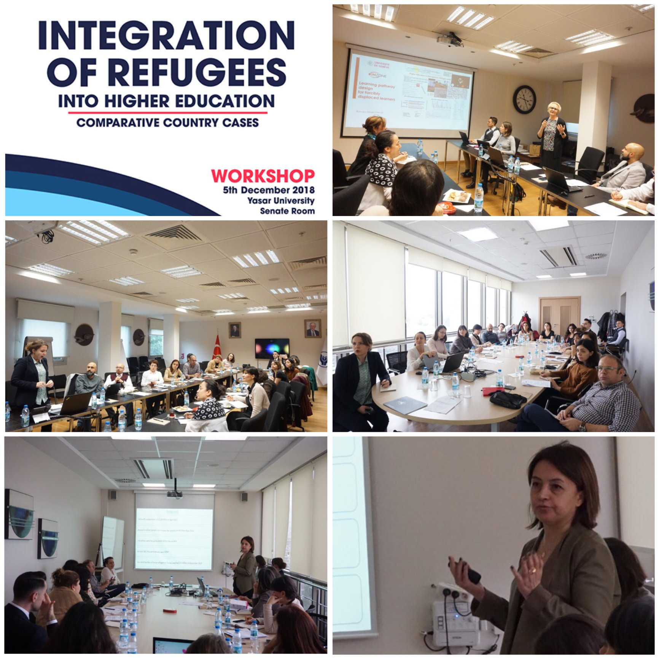

Slide 11

Report:
REFUGEE STUDENTS IN EUROPEAN HIGHER EDUCATION: COMPARATIVE COUNTRY CASES
(Germany, Netherlands, Norway, Spain, United Kingdom, Turkey)

Slide 12
TEŞEKKÜRLER
ayselinyildiz@gmail.com

