Slide 1

Impacts of COVID-19 pandemic on informal jobs and housing conditions among citizens and refugees:
The Case of Izmir, Turkey
June 11, 2021
Ayselin YILDIZ, Yasar University
Selin SIVIS, IDS and Essex University
Dolf te Lintelo, Institute of Development Studies
Meltem GUREL, Yasar University
Project: Wellbeing and Housing Infrastructures in Urban Turkey (WHIT),
Funded by British Academy Urban Infrastructures of Wellbeing Programme

Slide 2
Outline
Refugee Context and COVID-19 Situation in Turkey
WHIT Project Info and Initial Research Findings
Research Question
How to explain the perceptions and experiences of low-income Turkish citizens and refugees in Izmir about the COVID-19 pandemic in terms of the well-being impact on informal employment and housing?

Slide 3
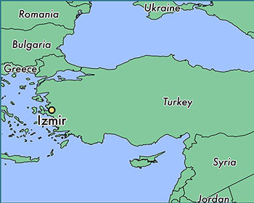
Refugee Context in Turkey
Turkey hosts the world’s largest refugee population: 4 million (3,6 million Syrians, 10th year of first arrival)
Overview: Syrians’ legal status, granted rights
Permanent temporariness: Path of return X Integration
(State discourse and policy realities) Citizens’ perceptions over time
Housing situation in Izmir for Syrians (Two cases: City-Basmane and Rural-Torbali)

Slide 4
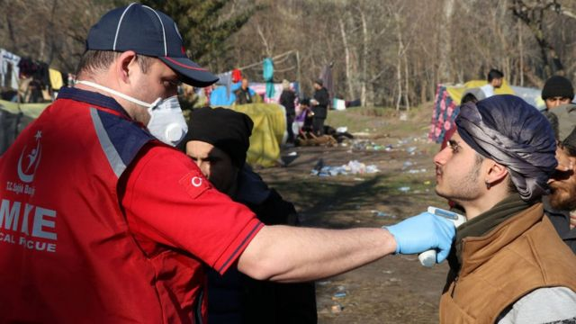
Overview: COVID-19 situation in Turkey
Items | Number
Number of tests | 55,6 million
Number of infected people | 5,2 million
Number of deaths | 48.255
Numbr of recoveries | 5,1 million
Number of vaccination (1st and 2nd doses) | 31,2 million
What about COVID-19 situation for Refugees in Turkey and vaccination of Syrians?
Sensitive issue in the context of increasing anti-Syrian sentiments among the host society
Resource: Ministry of Health, https://covid19.saglik.gov.tr
BioNTech/Pfizer, Sinovac CoronaVac, Sputnik V. Six vaccines in clinical trials in Turkey
Vaccination takes place acc.to priority groups:
Frontline workers in health and social care settings
People over the age of 50

Slide 5
State response to COVID-19 and impacts
The first wave:
-closing borders (except for citizens and returning residents), stopping flights, closing schools, mosques, and non-essential shops, suspending large gatherings, introducing lockdown measures for specific age groups, announcing social distancing precautions, introducing restrictions on inter-city travel and using public transportation
The second wave:
-introducing online education, allowing only take-away service for café and restaurants, employing partial curfew measures, implementing lockdown-measures for specific age groups, closing bars, night clubs, cinemas, theaters, suspending flights with some countries, introducing flexible working in private and public sectors
We can review some economic impacts of lock downs: introducing Economic Stability Shield package (e.g. postponing the capital and interest payments, providing stock financing support to exporters etc.), short term work allowance, paying employees' general health insurance payments, cash assistance to small and medium businesses

Slide 6
WHIT Project Info
“Wellbeing, Housing and Infrastructure in Turkey” funded by British Academy
Key informant interviews in Izmir:
  16 expert interviews (Local administrators, NGOs, public authorities, municipality)
  9 Syrian refugee
  9 low-income Turkish citizen
  Total: 34 in-depth, semi-structured interviews

Slide 7
Key research findings
150,000 registered Syrians in Izmir. Migration-receiving city (Domestic and international, transit hub and destination for migrants)
Share of resources: low-income Turkish citizens (Romans, Kurds, Turks), domestic migrants and Syrian refugees
Vulnerable groups living together Space: Living in shared poor districts
Time: More than 20 years of domestic migrants and 10 years of Syrians
No serious conflicts however competing for limited resources
Challenge: Lack of local authorities/municipalities competece in migration governance.
Political polarization is high, however market economy functions irrespective of politics (landlord relations, cheap labour, informal employment)

Slide 8
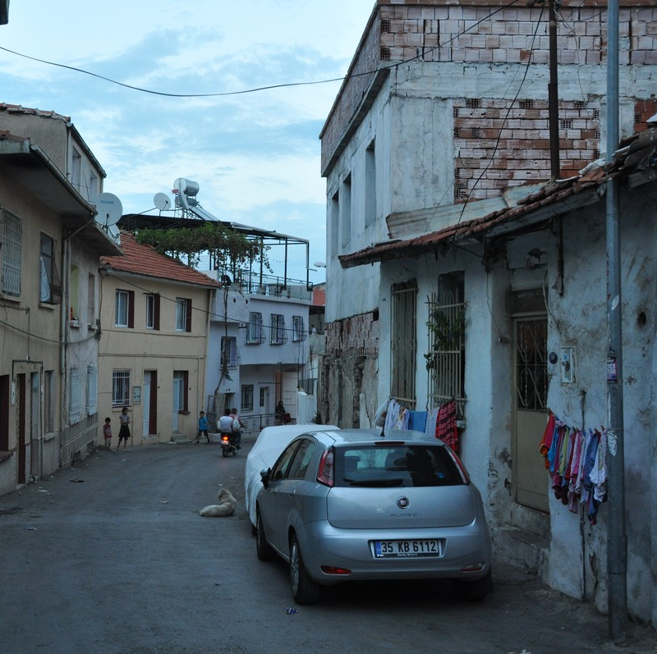
COVID-19: Impacts on housing and wellbeing (city Izmir)
Over-crowded houses, failures of urban planning already exists.
Syrians live in old houses, ruined, poor infrastructure, high rents
Common sanitation problem- due to being archaeological site (preservation area) restoration of registered buildings are costly
Difficulty in paying the rent and monthly bills.
Increased rents due to Izmir earthquake in October 2020 and COVID-19
Locals’ attitude: Complaints about sanitation habits of Syrian refugees –Living space image
Source:Ege'nin Sesi

Slide 9
“You cannot bring two troubled cultures side by side and expect that friendship and brotherhood will come out of it. One group identify themselves as the actual citizens of Turkey and somehow they’ve heard about that (and I’m not sure of its accuracy, either) the other group is sometimes tax exempt, and that they receive (governmental) aid”.
Interviewee, Izmir History Project
When they first come, the residents, locals of this district, we met and decided to kick them out of this district. The locals said "we do not want Syrians here". However, we were not successful, they remained. Now we all accepted that they will not return, we understood we have to live together, they will not go. So, all we accepted this fact. Actually, they do not create any tension or problem. They are silent. I observed no competition with the locals, everyone finds their own way. Mukhtar in Torbali

Slide 10
Local community does not identify themselves as discriminating Syrians. Discourse towards Syrians: noisy, crowded families, not caring about hygenic rules.
Syrians claim no serious disrimination towards them but address low social interaction with the locals.
Remarkably, discriminative discourses are observed against Roman people rather than Syrians.

Slide 11
COVID-19: Impacts on housing and wellbeing (Urban Torbalı)
Types: Farm land tents, derelict factories, houses, backyard sheds
Connection with city center is weak. Not existing public transport opportunities. Isolated.
Problems: garbage collection, water-supply, education, access to toilets and health.
Actually, I heard no one had seriously Coronavirus among Syrians. The people who work in the farms or who gets used to work under hard conditions I think are strong and they do not get the virus easily.
Mukhtar in Torbali
COVID-19 infection rate among seasonal agricultural laborers is very low. Because they are isolated from the rest of society. They do not travel to city center often.
Development Workshop, NGO

Slide 12
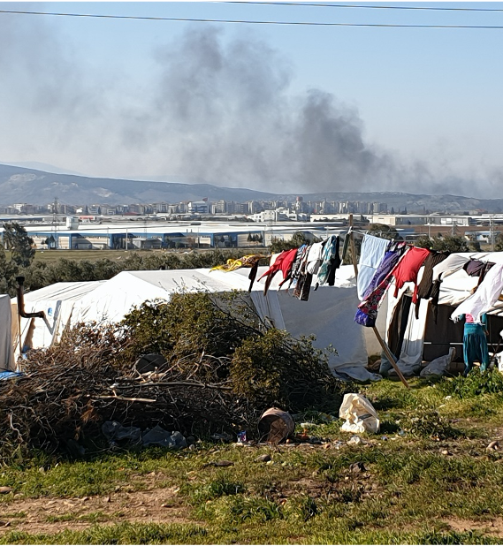
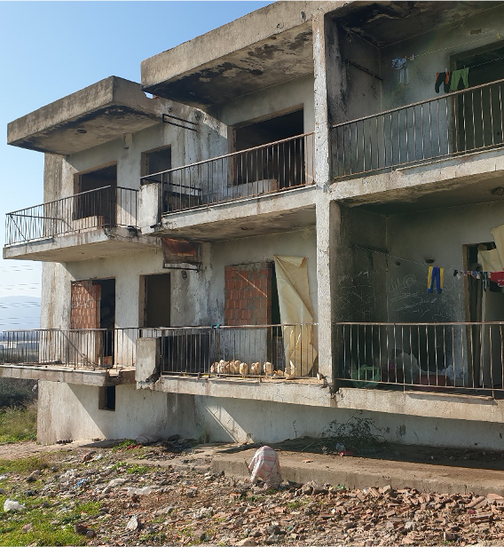

Slide 13
Syrians as seasonal workers in agriculture. Torbalı is dependent to Syrian workers in the farms
“We need Syrians in our farms, in agriculture sector. If we do not have them, we would have serious difficulty in harvesting the products. No one would do it. Thanks to Syrians. They are able to, capable of working well in the agriculture”
Torbalı District Governor
“I am not informed about any obvious conflict between Syrians and Turkish people living in the tents… We see that Syrians substitute for Turkish workers. We cannot deny that this situation leads to hidden competition between Turkish and Syrian workers. When pandemic emerged, most of Syrians went to work regardless of the outbreak of COVID. Besides, they were also willing to work more and for lower wage”.
”
Mukhtar in Torbalı

Slide 14
Impacts on housing and wellbeing in Torbali (peri-urban)
Health center capacity
No internet, access to education?
One family doctor is not able to give service more than 8.000 people. Thus, the people have to travel to other districts. People are poor they do not have money to travel to other districts.
Mukhtar in Torbali
Hygiene is the main issue. Rain, mud…There is no water channel system. Living conditions are horrible. There is no hygiene education. There is a need to improve their awareness. We give them hygiene and soap training, but they don’t have a proper place where they can wash their hands and put their soap. They have to use water very carefully in places where water comes through tankage. Not being able to wash hands, brushing teeth… No sufficient resources… Medecine du Monde Izmir, NGO

Slide 15
Informal employment
Informal employment among low-income Turkish citizens and Syrian refugees is common. More than 30%
Pandemic Impact: Loss of income, daily jobs mainly in textile, construction and service sector. Low skilled profile. No benefit could be received.
Competing poverty between locals and refugees
Government’s limited social aid to citizens- International organizations’ limited aid to refugees
Food and hygiene material- While talking about integration and resilience strategies after 10 years, the approach returned to livelihood support again.
Frequent move to cheaper housing
Residental address required for acess to state aids

Slide 16
The Turkish citizens lived under the same spatial conditions as the Syrians, and when they saw that their neighbors got all the aid and they didn’t, a seriously xenophobic attitude started to develop toward Syrians based on financial reasons. Generally speaking, Syrians were more disadvantaged, but the Turkish people were disturbed by, for instance, Syrians’ receiving free healthcare services
Izmir Kapilar Initiative, NGO
We’re okay, not many people who got sick, but financially we’re deeply affected. Many people lost their jobs.
Respondent 4, Turkish citizen

Slide 17
Q&A Session
Ayselin YILDIZ, Yasar University, ayselin.yildiz@yasar.edu.tr
Selin SIVIS, IDS and Essex University, selin.sivis@yasar.edu.tr
Dolf te Lintelo, Institute of Development Studies, D.TeLintelo@ids.ac.uk
Meltem GUREL, Yasar University, meltem.gruel@yasar.edu.tr

